Slide 1
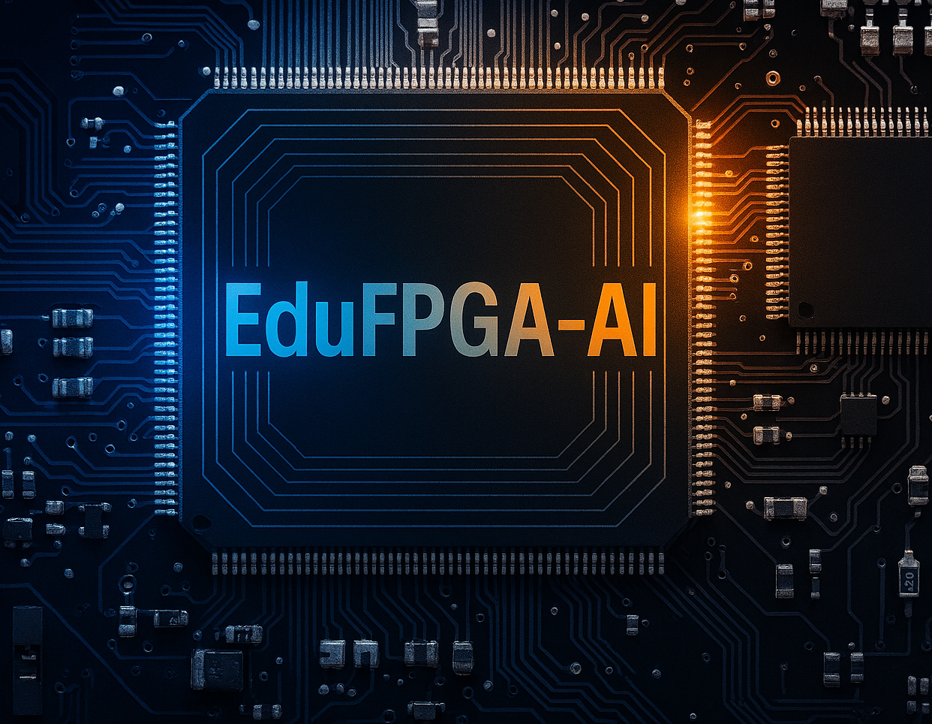
Educational Platforms for Learning AI on FPGA Hardware
Mohamed Abdo
Hamm-Lippstadt University of Applied Sciences
Prof. Dr. –Ing. Ali Hayek
[08.12.2026]

Slide 2
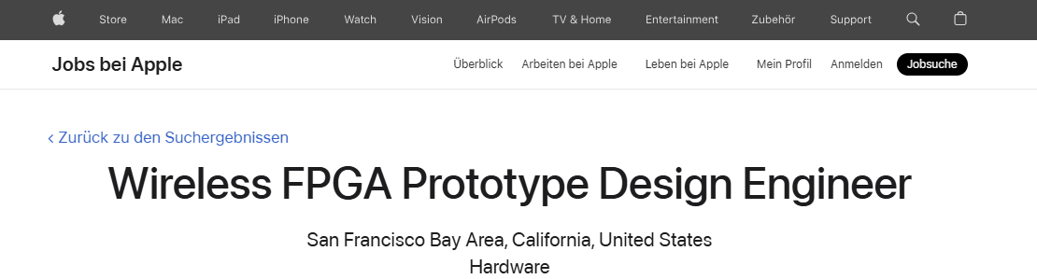

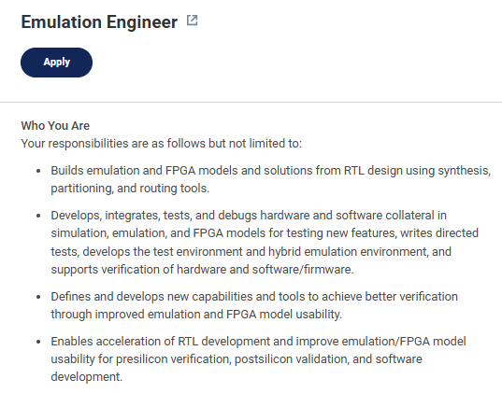
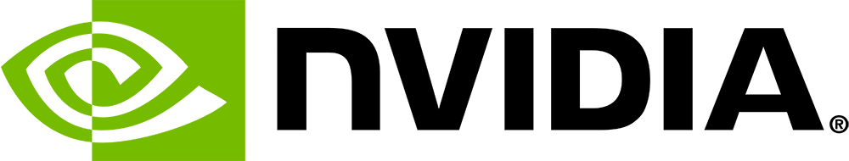
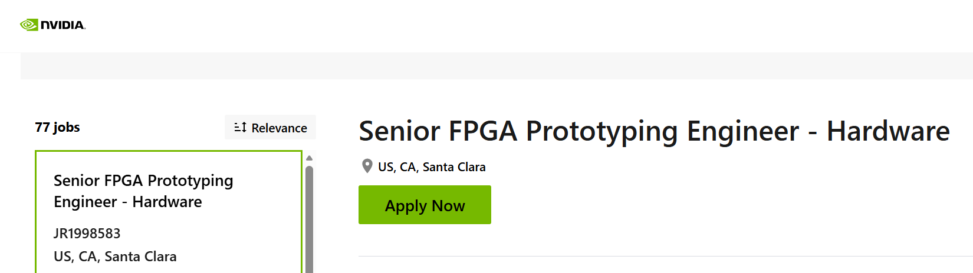
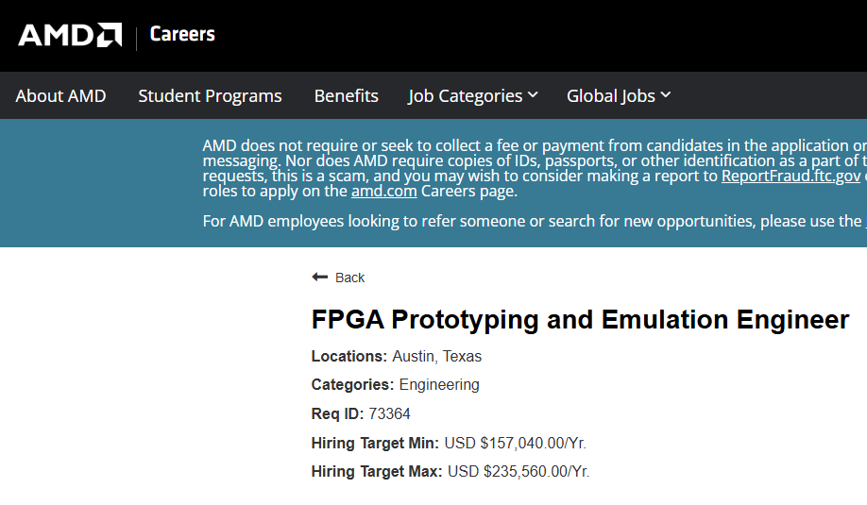
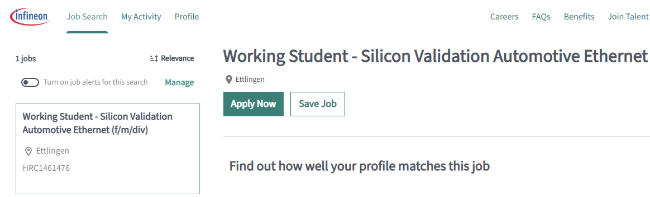

Motivation
Skills Acquired?

Slide 3
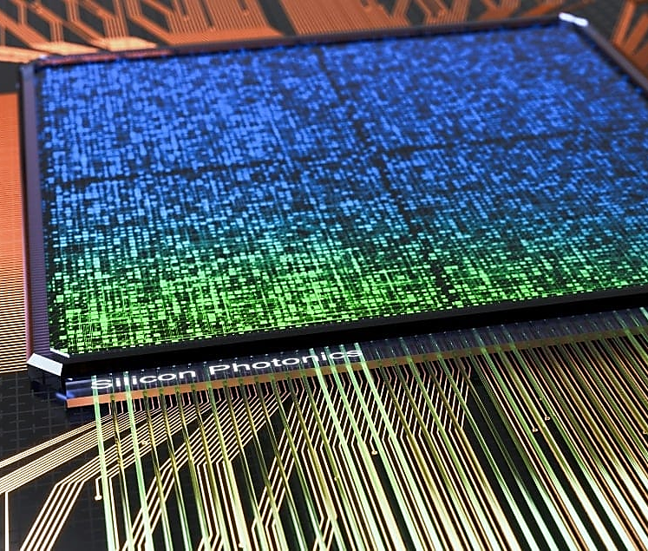
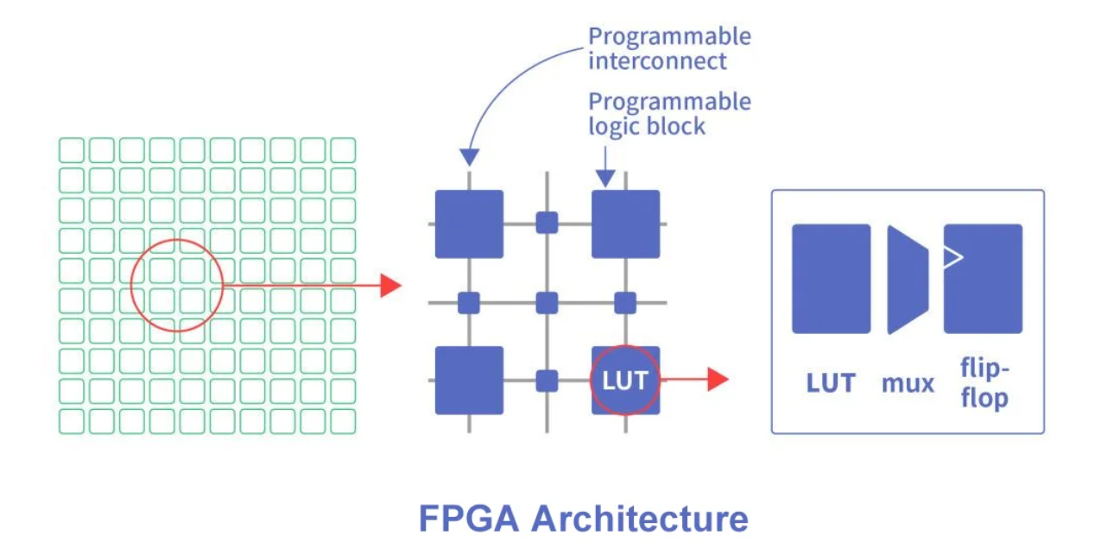
What is FPGA-AI?
1- Standalone FPGAs:
Programmable Logic Blocks
Thousands/millions of identical units
Basic digital components: LUTs, flip-flops, gates
Building blocks for any digital circuit without new silicon
Programmable Interconnects
Re-routable wiring network
Connects logic blocks in any configuration
Enables custom circuit pathways
Hardened Components (Modern FPGAs)
Fixed-function blocks for efficiency:
DSP slices: Optimized math operations
Block RAM (BRAM): High-speed memory
AI Engines: Dedicated neural network hardware (AMD Versal)
Unlike:
CPU: Fixed hardware architecture, programmed with software
GPU: Massively parallel, but still fixed-architecture processor
FPGA fully reconfigurable

Slide 4
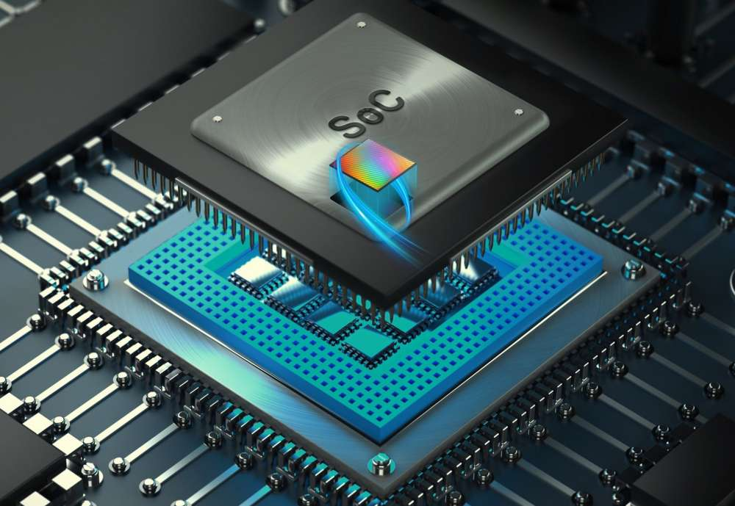
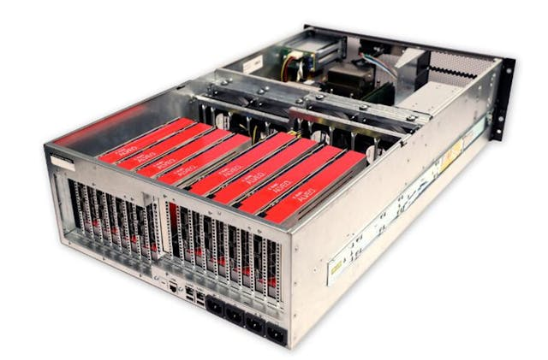
What is FPGA-AI?
SoC FPGA ex: Zynq UltraScale+ MPSoC CHIP
Power Efficiency: The Fabric FPGA only activates the exact logic needed for the task; the processor handles complex software chores.
High-End FPGA: Data Center Acceleration (Alveo)
Huge FPGAs: Largest capacity available
High-Bandwidth Memory (HBM): 16-32GB, ultra-fast access
FPGA Hardware Flexibility. Can be reconfigured to become any digital circuit.

Slide 5
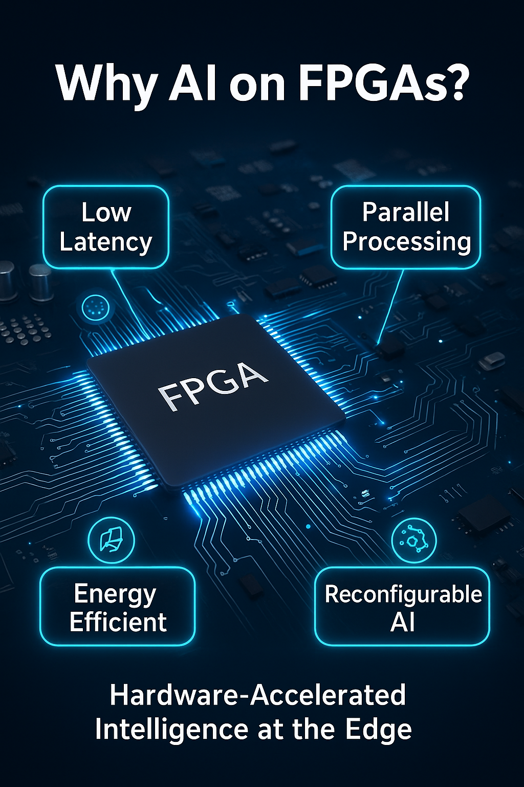
Flexibility & Reconfigurability: You can update the hardware architecture as your AI model evolves, unlike a fixed ASIC. This is ideal for rapidly changing algorithms or for deploying different models to the same hardware at different times.
Low Latency: Data flows directly through the custom circuit with minimal overhead, crucial for real-time applications. (Medical Application & Linear regression predection)
IEEE Xplore Full-Text PDF:
Power Efficiency: Because the circuit is custom-built for the task, it performs the exact operations needed with no wasted energy on fetching/decoding generic instructions.
And Deep neural networks (DNNs) require more computing power and storage than most mobile devices can provide
IEEE Xplore Full-Text PDF:
Parallelism: You can design a circuit with hundreds or thousands of parallel processing elements, all working simultaneously on different parts of the data.
Memory-augmented neural networks (MANNs), which in clude memory networks which is difficult to parallelize on CPUs or GPUs. IEEE Xplore Full-Text PDF:
Custom Datapaths: You can design the exact bit-width needed (e.g., 8-bit integer for quantized models), avoiding the waste of generic 32-bit floating-point units in CPUs/GPUs.

Slide 6
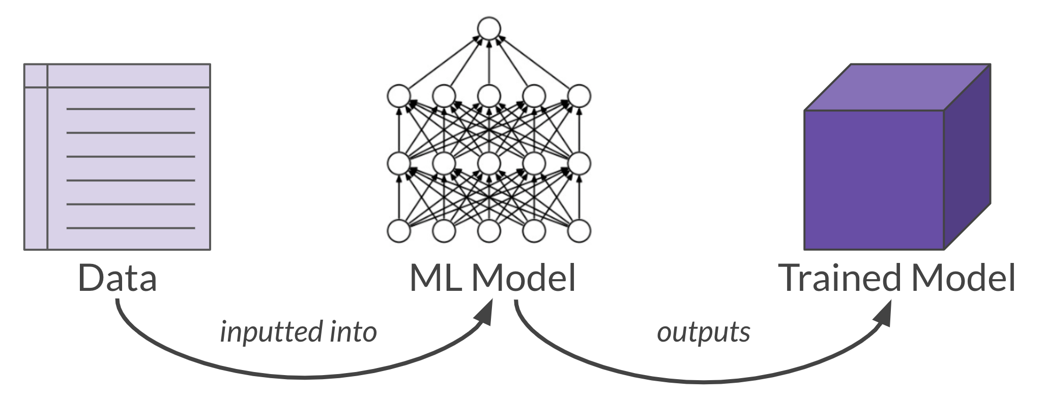
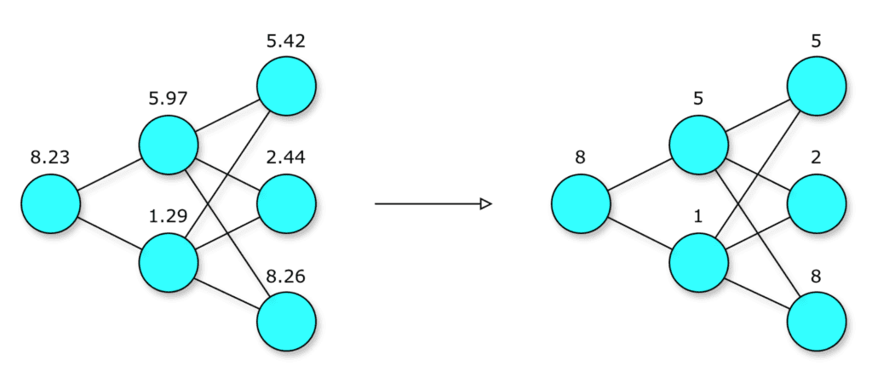
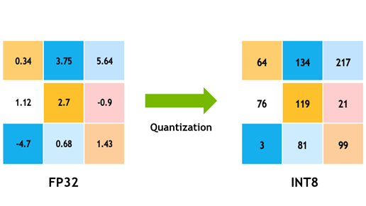
Quantization & Deployment FLOW
Quantization: Convert 32-bit floats → 8-bit integers
Result: ~4x smaller model, ~2-4x faster, minimal accuracy loss

Slide 7
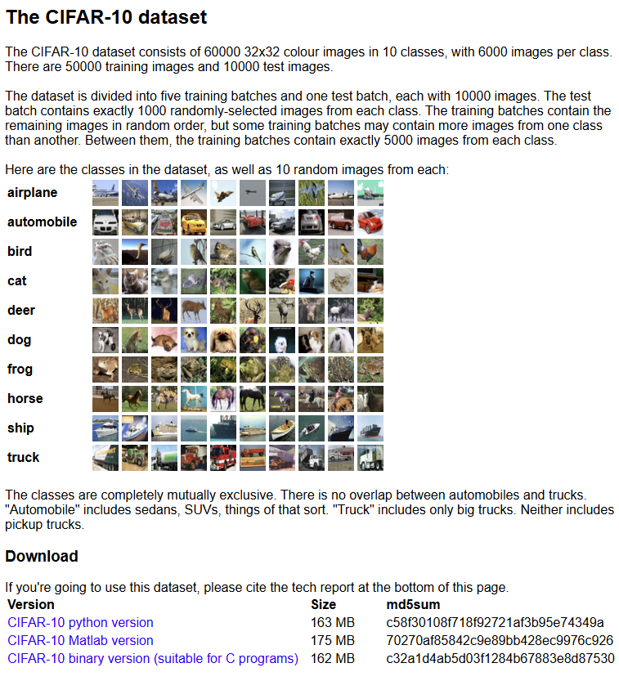
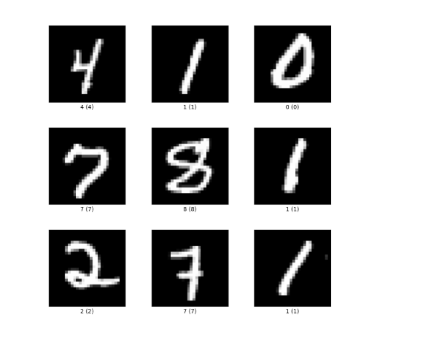
Datasets:
CIFAR-10 and CIFAR-100 datasets
mnist | TensorFlow Datasets

Slide 8
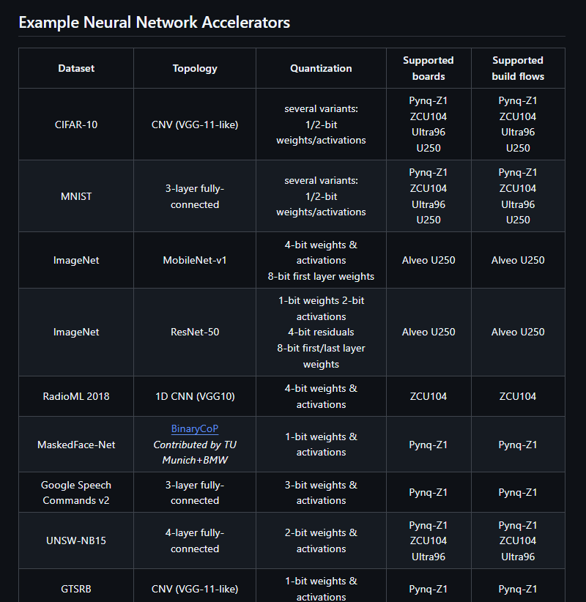
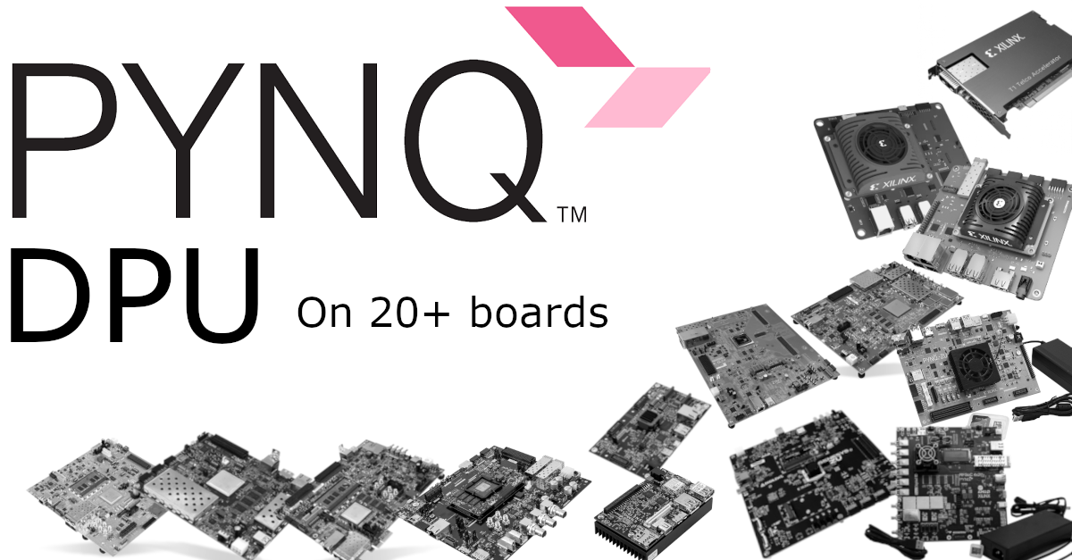
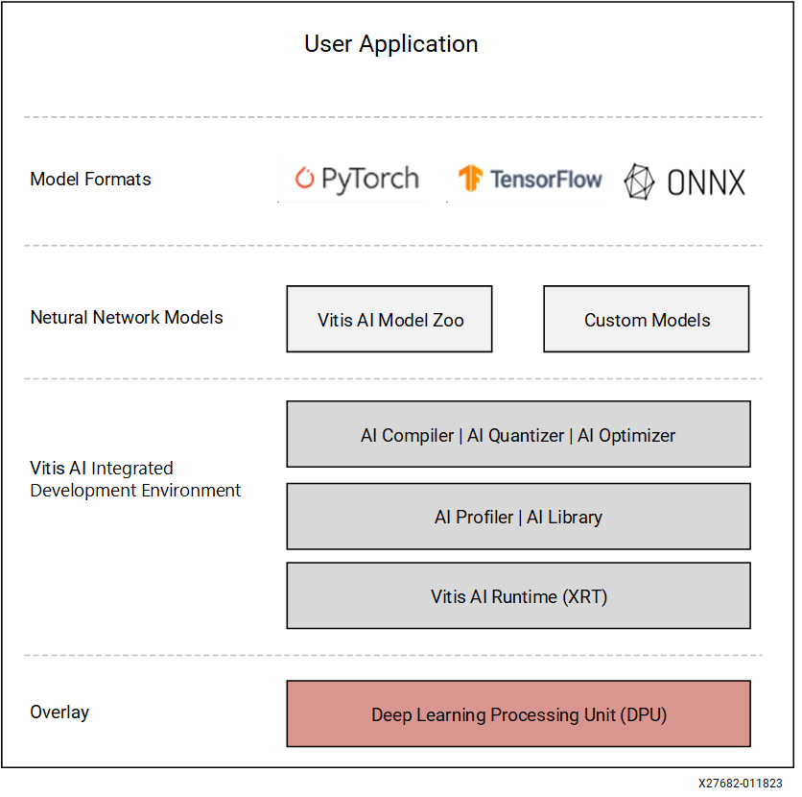
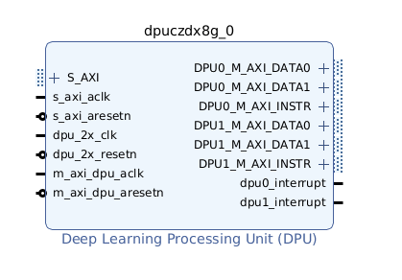
Main headlines
DPU = Deep Learning Processing Unit (Xilinx IP).
DPU: tiny low-power accelerator running directly on FPGA with customizable architectures
How it fits into PYNQ
On PYNQ, the DPU is exposed like a Python library, so you can run inference using Python notebooks without writing HDL or Vitis AI C++ code.
You load a bitstream that contains the DPU.
Then use pre-built Python APIs to:
load a model (.xmodel format)
feed input tensors
receive outputs
part of the Vitis AI ecosystem and targets:Zynq UltraScale+ MPSoC (e.g., ZCU102, ZCU104, Ultra96, KRIA)
Why use DPU instead of CPU?
Massive parallelism for:
conv layers
pooling
batch normalization
activation functions
Lower latency
Lower power consumption
Real-time performance on edge AI devices
Typical speedups: 20×–100× faster vs pure ARM CPU inference, depending on the network.
DPU Configuration • DPUCZDX8G for Zynq UltraScale+ MPSoCs Product Guide (PG338) • Reader • AMD Technical Information Portal

Slide 9
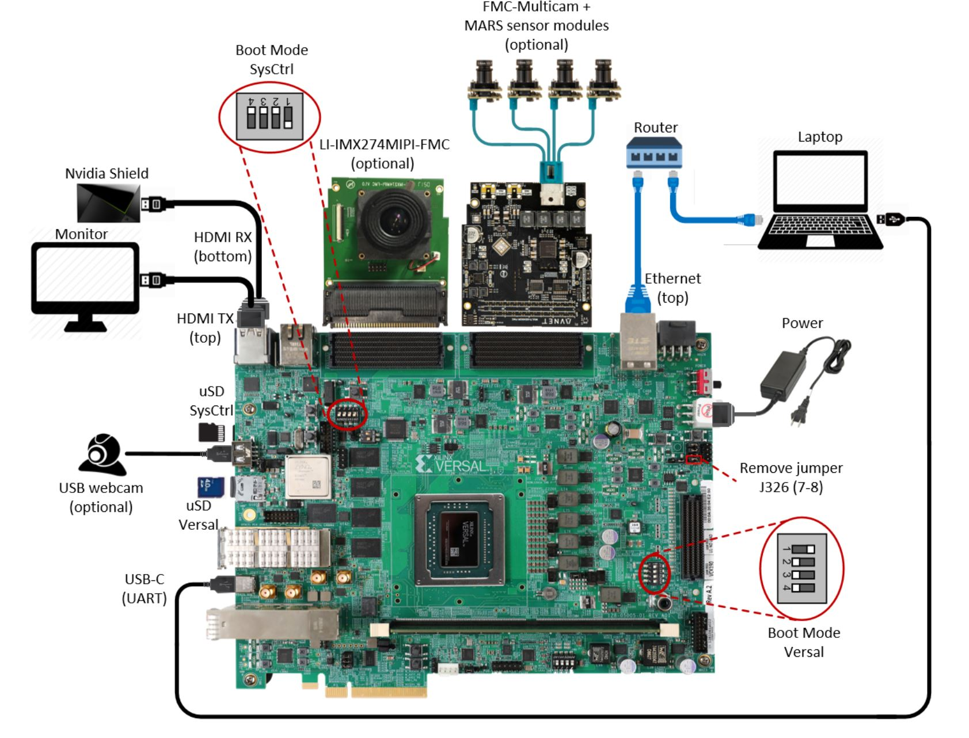

Slide 10
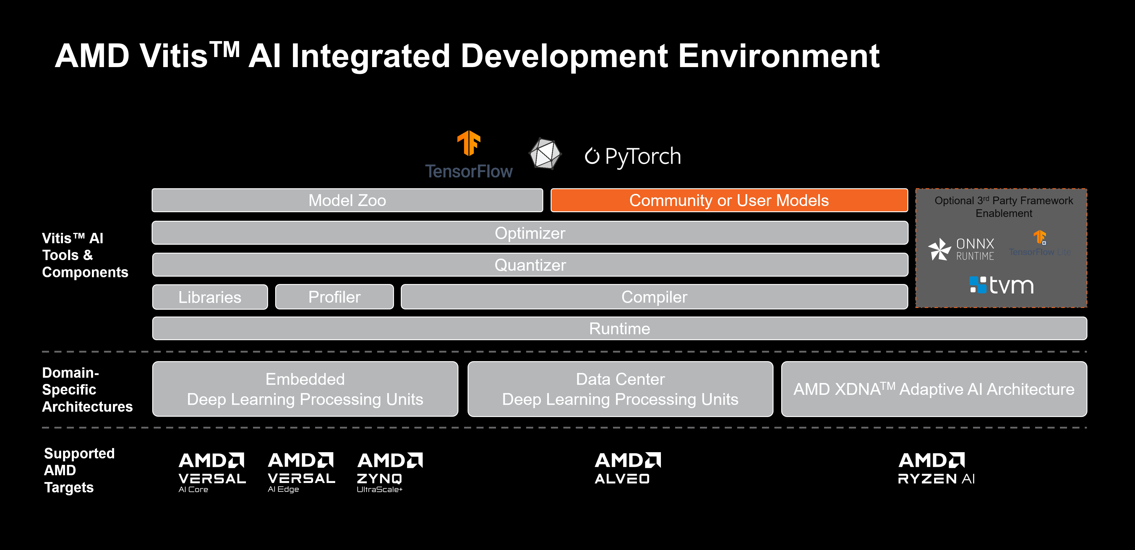
Vitis AI
Xilinx/Vitis-AI: Vitis AI is Xilinx’s development stack for AI inference on Xilinx hardware platforms, including both edge devices and Alveo cards.

Slide 11
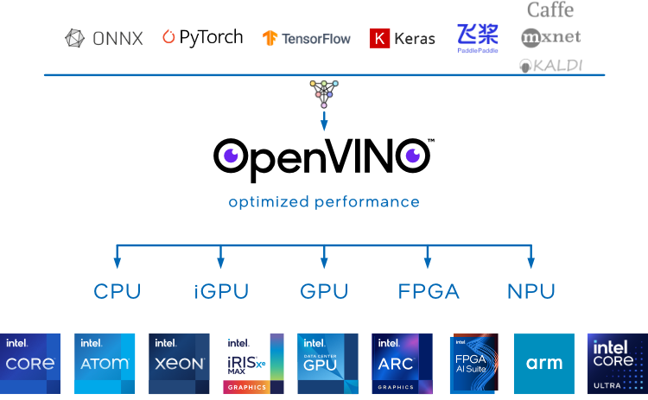
Intel OpenVINO
OpenVINO 2025.4 — OpenVINO™ documentation — Version(2025)

Slide 12
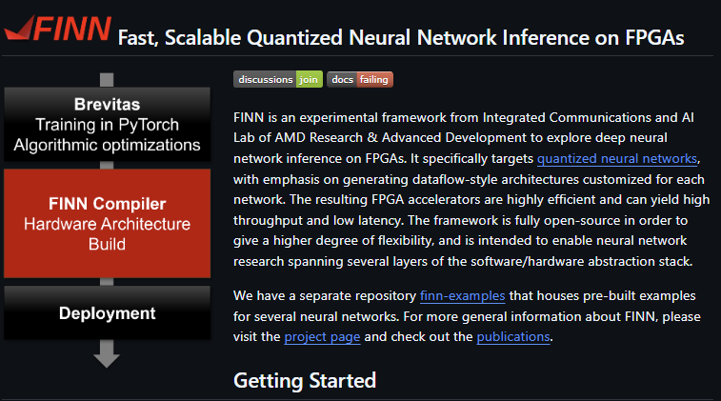
Xilinx/finn: Dataflow compiler for QNN inference on FPGAs

Slide 13
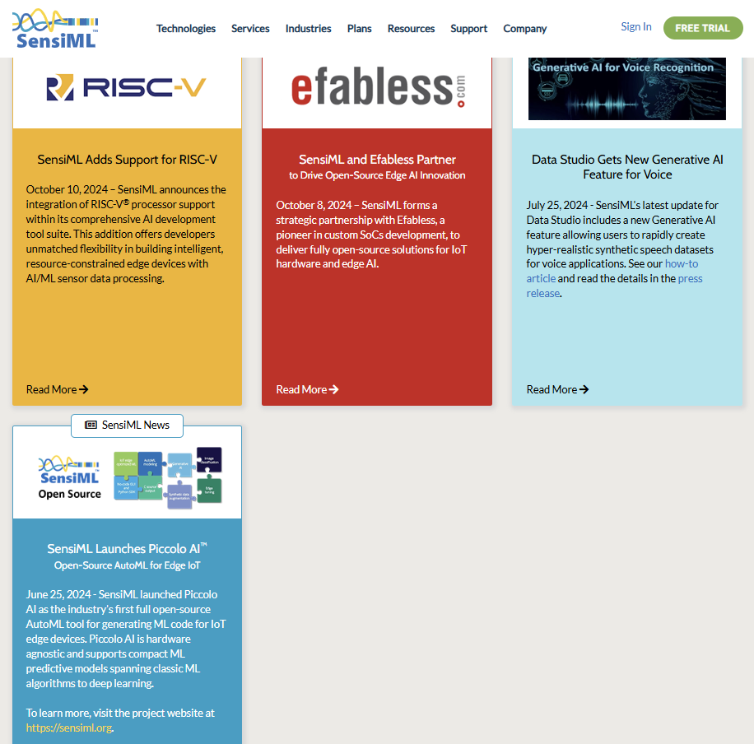
SensiML – Picolo AI

Slide 14
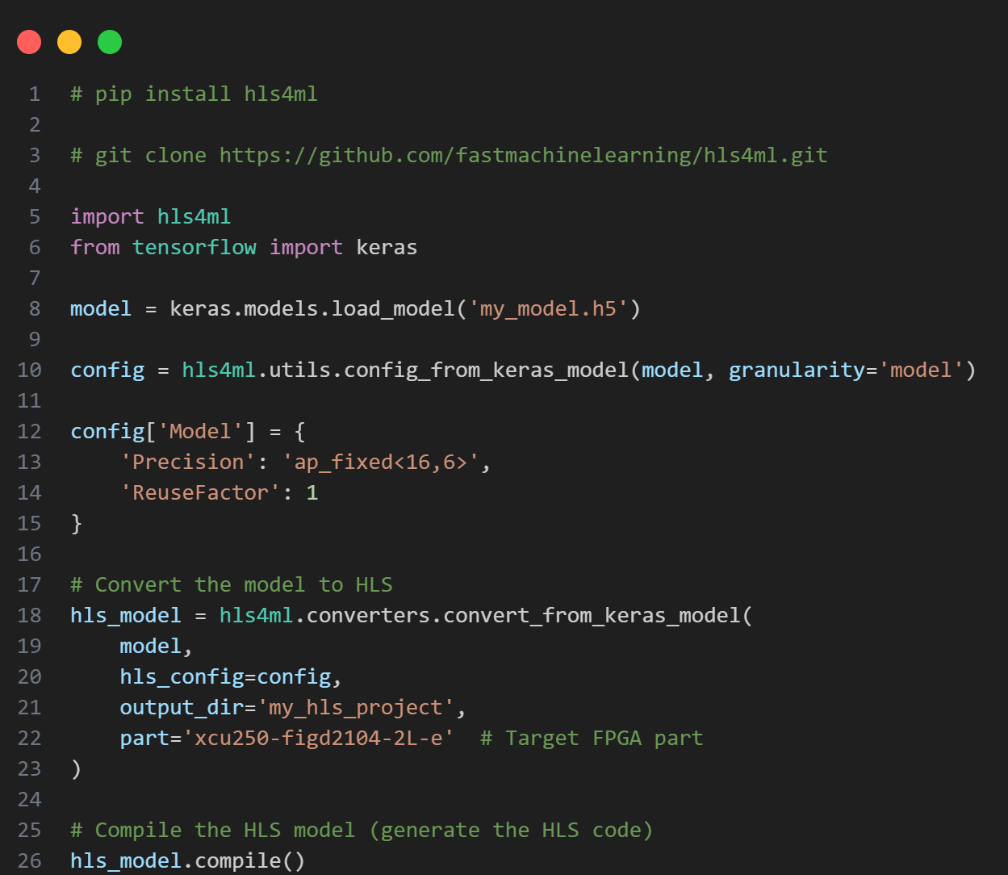
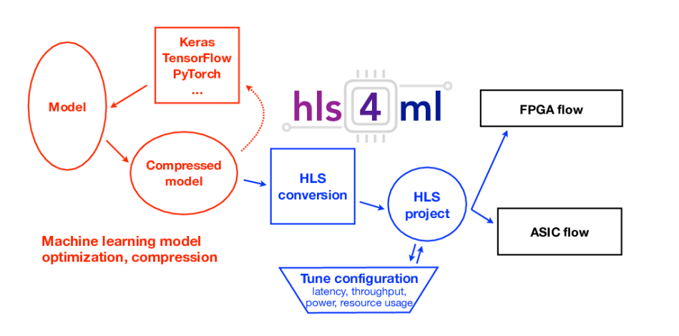
hls4ml
hls4ml (High-Level Synthesis for Machine Learning) is an open-source framework for converting machine learning models (especially neural networks) into FPGA firmware. It allows researchers and engineers to deploy models on FPGAs with high performance and low latency.

Slide 15
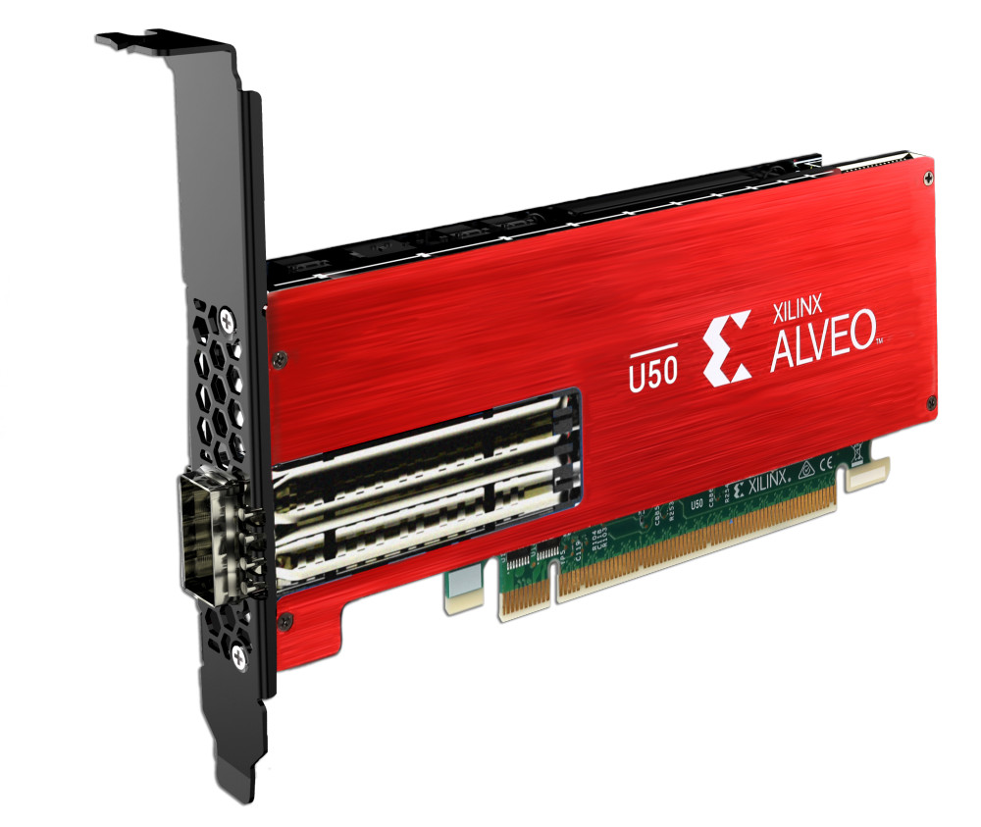

Slide 16
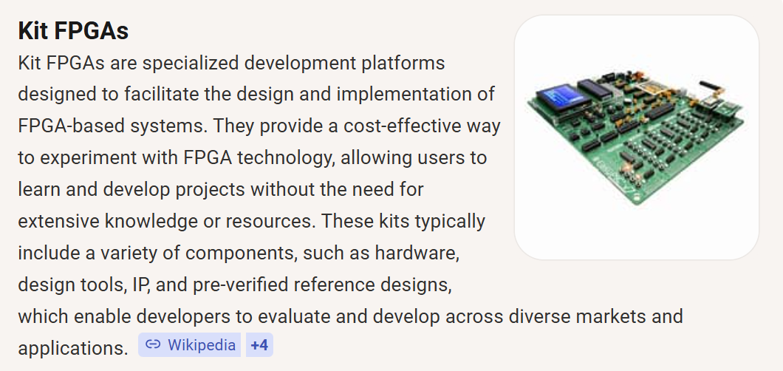
SoC

Slide 17
recommandation
Ultra96-V2 projects

Slide 18
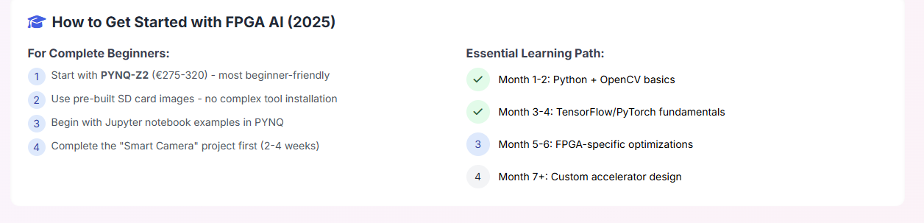
How to Get Started with FPGA AI

Slide 19
TRADITIONAL FPGA COMPLEXITY
Traditional FPGA Workflow:
AI Model → HDL Coding → Synthesis → Place & Route → Bitstream
Barriers for Students:
• Hardware Description Languages (VHDL/Verilog)
• Complex vendor toolchains (Vivado/Quartus)
• Steep learning curve for AI-focused students
• Time-consuming design process

Slide 20
HIGH-LEVEL SYNTHESIS (HLS)
What is HLS?
• Converts C++/Python to hardware descriptions
• Abstracts away HDL complexity
• Enables algorithm-focused design
Educational Impact:
• Students describe behavior, not hardware
• Focus on AI algorithm optimization
• Faster prototyping and experimentation
• Bridges software-hardware gap

Slide 21
QUANTIZATION: KEY TO EFFICIENCY
Mathematical Foundation:
Q(x) = Δ · round(x/Δ)
Δ = 2 · max(|x|) / (2ᵇ - 1)
Three Approaches:
1. Post-Training Quantization (PTQ)
- Simple but less accurate
2. Quantization-Aware Training (QAT)
- Accurate but complex
3. Extreme Quantization (1-2 bit)
- Maximum efficiency, specialized

Slide 22
PLATFORM COMPARISON: ACCESSIBILITY FOCUS
AMD PYNQ:
• Python + Jupyter notebooks interface
• Zynq boards with ARM + FPGA
• Ideal for beginners
• Rapid prototyping
Vitis AI:
• Production-ready toolchain
• Automated quantization
• End-to-end deployment
• Industry standards
Educational Value: Lowering entry barriers

Slide 23
PLATFORM COMPARISON: DEPTH FOCUS
hls4ml (High-Energy Physics):
• Transparent model-to-hardware translation
• Fine-grained quantization control
• Educational focus: Understanding the process
FINN (Extreme Quantization):
• Binary/ternary neural networks
• Streaming dataflow architectures
• Maximum efficiency demonstrations
Educational Value: Conceptual depth and transparency

Slide 24
HANDS-ON WORKFLOW EXAMPLE
MNIST Classification on PYNQ-Z2:
1. Train & Quantize
- Keras/TensorFlow model
- Precision reduction experiments
2. Configure hls4ml
- Layer-specific bit-widths
- Resource constraints
3. Hardware Optimization
- Parallelism vs resources
- Reuse factor adjustment
4. Generate & Deploy
- HLS code generation
- Performance comparison
Learning Outcome: Complete hardware-software co-design understanding

Slide 25
EDUCATIONAL IMPACT
Democratization:
• Lowers barrier for CS/AI students
• No hardware expertise required initially
Conceptual Depth:
• Hands-on quantization experience
• Parallelism understanding
• Resource constraint awareness
Systems Thinking:
• Algorithm to silicon understanding
• Cross-layer optimization skills
Innovation Stimulation:
• Prototype novel accelerators
• Research exploration

Slide 26
IDENTIFIED CHALLENGES
Toolchain Complexity:
• Vendor tools remain difficult
• Installation and licensing issues
Resource Constraints:
• Limited educational hardware
• Overly simplified models required
Abstraction Leakage:
• Debugging requires hardware knowledge
• Cryptic error messages
Quantization Trade-offs:
• Accuracy vs efficiency decisions
• Numerical precision understanding
Curriculum Development:
• Significant instructor effort
• Balancing depth vs accessibility

Slide 27
RESEARCH DIRECTIONS
Cloud-Based Labs:
• Eliminate local installation issues
• Equitable access for all students
Enhanced Visualization:
• Model-to-hardware mapping tools
• Interactive debugging interfaces
Quantization Pedagogy:
• Real-time precision analysis
• Visual trade-off demonstrations
Broader Integration:
• Embedded systems curriculum
• Multi-platform comparisons
End-to-End Systems:
• Sensor-to-actuator intelligent edge
• Real-world application focus

Slide 28
INTRODUCING: EDUFLOW
A Proposed Educational Platform
Vision:
Progressive disclosure platform that grows with student expertise
Core Philosophy:
• Start simple, reveal complexity gradually
• Maintain conceptual transparency
• Integrate best practices from existing platforms
Target Gap:
Current platforms prioritize either accessibility OR depth
EduFlow delivers BOTH through progressive learning

Slide 29
PLATFORM ARCHITECTURE
EduFlow Architecture:
[Web Interface] ←→ [Educational API Layer] ←→ [Abstraction Engine]
↓
[Visual Debugger] ←→ [Hardware Abstraction] ←→ [Multi-Backend Support]
↓
[PYNQ] [hls4ml] [Vitis AI] [FINN]
Key Components:
• Unified Web Interface - Browser-based accessibility
• Educational API - Simplified commands for beginners
• Visualization Layer - Real-time hardware mapping
• Multi-Backend - Leverages existing platforms
• Progressive Mode - Reveals underlying commands

Slide 30
MULTI-LEVEL FEATURES
For Beginners:
• Drag-and-drop model building
• One-click deployment to FPGA
• Interactive quantization sliders
• Real-time performance feedback
For Intermediate Students:
• Exposed configuration parameters
• Comparative analysis tools
• Hardware resource visualization
• Step-by-step workflow inspection
For Advanced Students:
• Full backend tool access
• Custom optimization scripts
• Research experiment setup
• Performance profiling tools

Slide 31
INTERACTIVE QUANTIZATION LAB
Precision Exploration:
[FP32] ----[INT16]----[INT8]----[INT4]----[Binary]
Real-time Feedback:
Accuracy: 98% → 96% → 92% → 85% → 72%
Resources: 100% → 45% → 25% → 12% → 5%
Latency: 10ms → 4ms → 2ms → 1ms → 0.5ms
Educational Value:
• Immediate feedback on trade-offs
• Visual understanding of precision impact
• Encourages experimentation
• Builds intuition for hardware constraints

Slide 32
REAL-TIME VISUALIZATION
FPGA Mapping Display:
• Color-coded resource utilization
• Animated data flow through layers
• Parallelism visualization
• Bottleneck identification
Learning Impact:
• Concrete understanding of abstract concepts
• Debugging assistance through visualization
• Intuition development for hardware thinking
• Connects software decisions to hardware consequences
Visual Debugging:
• See why optimizations work or fail
• Understand resource constraints visually
• Learn hardware patterns through examples

Slide 33
DEVELOPMENT PHASES
Phase 1 (Months 1-6):
• Basic web interface and PYNQ integration
• Simple quantization visualization
• Beginner-level exercises
• Core educational API
Phase 2 (Months 7-12):
• Advanced visualization tools
• Multi-backend support (hls4ml, Vitis AI)
• Intermediate curriculum
• Comparative analysis features
Phase 3 (Months 13-18):
• Research-level features
• FINN integration for extreme quantization
• Custom optimization support
• Advanced learning paths
• Publication-ready results export

Slide 34
QUESTIONS & DISCUSSION
Thank You
Discussion Points:
• Your experience with existing EduFPGA-AI platforms?
• Challenges in hardware-software education?
• Interest in collaborative development?
• Suggestions for EduFlow features?
Let's build the future of FPGA-AI education together!

Slide 35
Refrences
Xilinx/Vitis-AI: Vitis AI is Xilinx’s development stack for AI inference on Xilinx hardware platforms, including both edge devices and Alveo cards.
IEEE Xplore Full-Text PDF:

